Slide 1
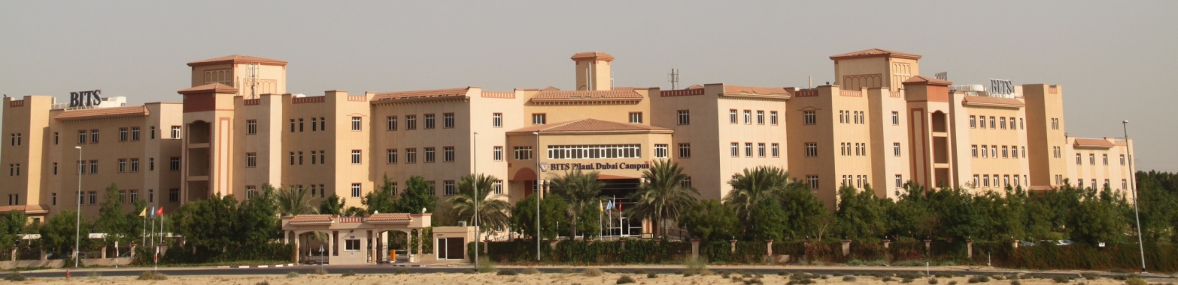
CS F342: Comp Architecture

Slide 2
About the Course
Course No. : CS F342 (3 1 4)
Course Title : Computer Architecture
LAB1:
Familiarization with MIPS Assembly Lang and QtSPIM

Slide 3
MP&IF vs CA/CO Course
In MP & IF Course
Software : x86 instruction set & programing in x86 assembly level program
Hardware : Programmer’s view of the x86 Processor.
(how instruction are executed).
Interfacing.: memory, peripherals – 8255,
Labs
TASM/TLINK/TD in dosbox (why??)
Can you execute an asm program in linux (if so how)
CA/CO: How is a processor designed :
We could have studied processor design using x86 (simplified ver).
But not so..
MIPS Processor (why not x86)
x86 : CISC processor,
MIPS Processor - RISC…
=> MIPS Instruction Set and Assembly Lang Program
=> Design of MIPS (simplified vers).

Slide 4
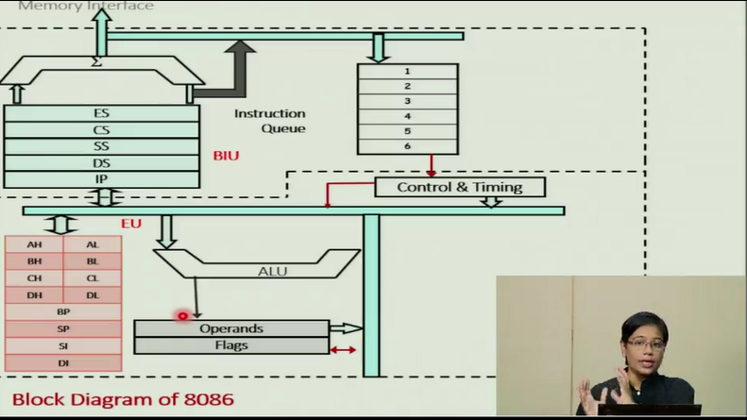
MP&IF vs CA/COCourse
MP Labs
TASM/TLINK/TD in dosbox (why??)
Can you execute an asm program in linux (if so how)
C:> tasm a1;
C:> tlink a1;
C:> a1
aaa
C:> td a1
.model small
.data
msg1 db “aaa", 0dh, 0ah, "$"
.code
main proc
mov ax,seg msg1
mov ds,ax
mov ah,09
lea dx,msg1
int 21h
mov ax,4c00h
int 21h
main endp
end main

Slide 5
MP&IF vs CA/COCourse
CA Labs
How do you assemble, link and execute MIPS asm progs on x86 CPU ?
Is this solution ok ?
On an intel (x86) machine can we do the following? (Yes/No)
C:> mips_asm a1; (similar to tasm a1)
C:> mips_link a1; ( tlink a1)
C:> a1 ( execue a1)
aaa
C:> mips_debugger a1 ( TD A1)
.

Slide 6
QTSPIM
CA Labs
How do you assemble, link and execute MIPS asm progs on x86 cpu?
Ans:
An executable binary (a.exe) for given processor arch cannot be directly executed on another processor arch.
So what is the solution??
Architectural Simulator:
Simulator is also a software program.
Capable of executing binary code of another processor (say mips, arm etc)
Have you worked with anything like this in 3rd sem.

Slide 7
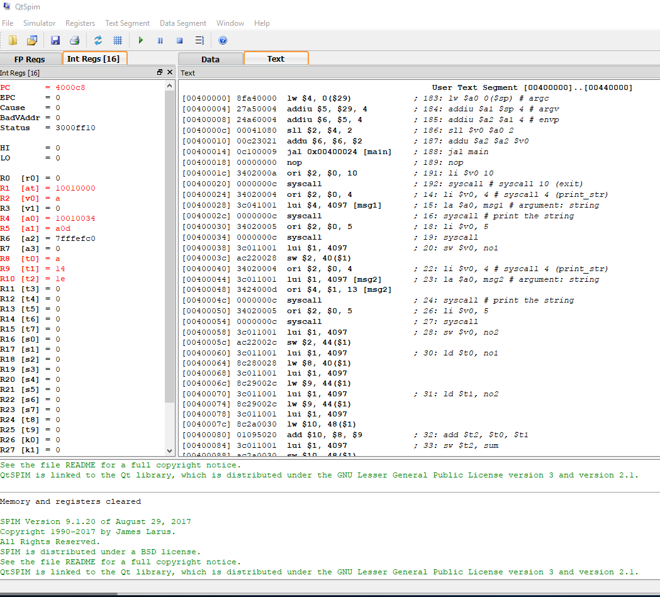
QTSPIM DEMO
QtSPIM (By James Laraus, Prof @wisc-mad, now @ms)
Simulator for mips processor (has an assembler also)

Slide 8
MIPS Assemble Lang Prog
.data
msg: .asciiz "Hello World"
.text
main: li $v0, 4 # syscall 4 (print_str)
la $a0, msg # argument: string
syscall # print the string
li $v0, 10 #
syscall #
.model small
.data
msg1 db “aaa", 0dh, 0ah, "$"
.code
main proc
mov ax,seg msg1
mov ds,ax
mov ah,09
lea dx,msg1
int 21h
mov ax,4c00h
int 21h
main endp
end main

Slide 9
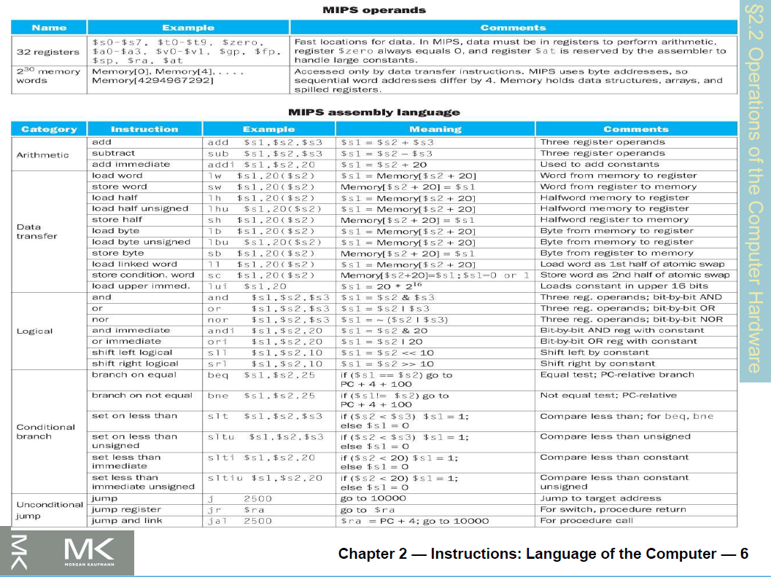
MIPS Instruction set

Slide 10
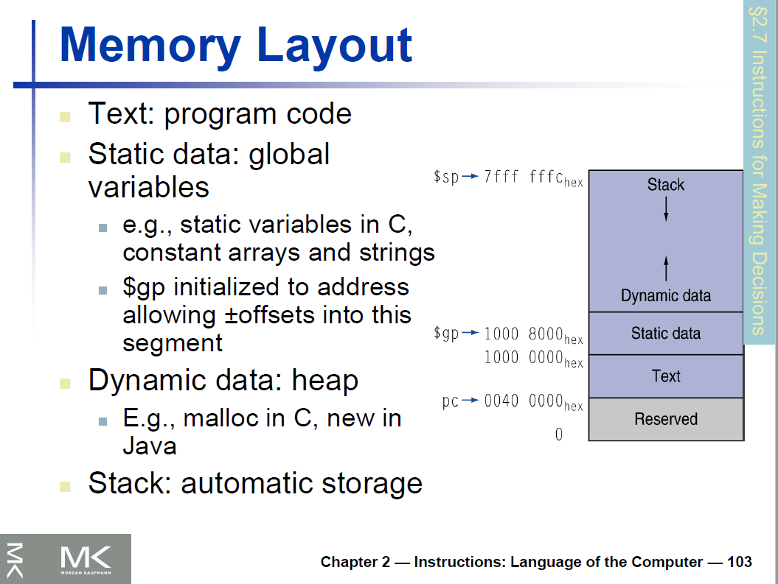
Memory Layout

Slide 11
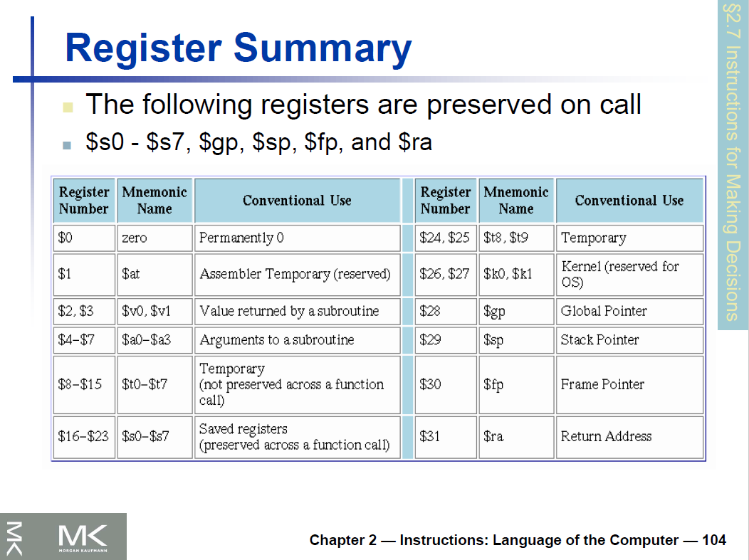
Register Summary

Slide 12
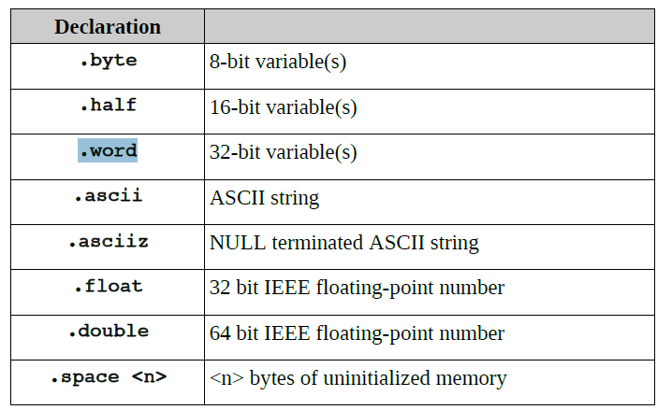
Assembler directives

Slide 13
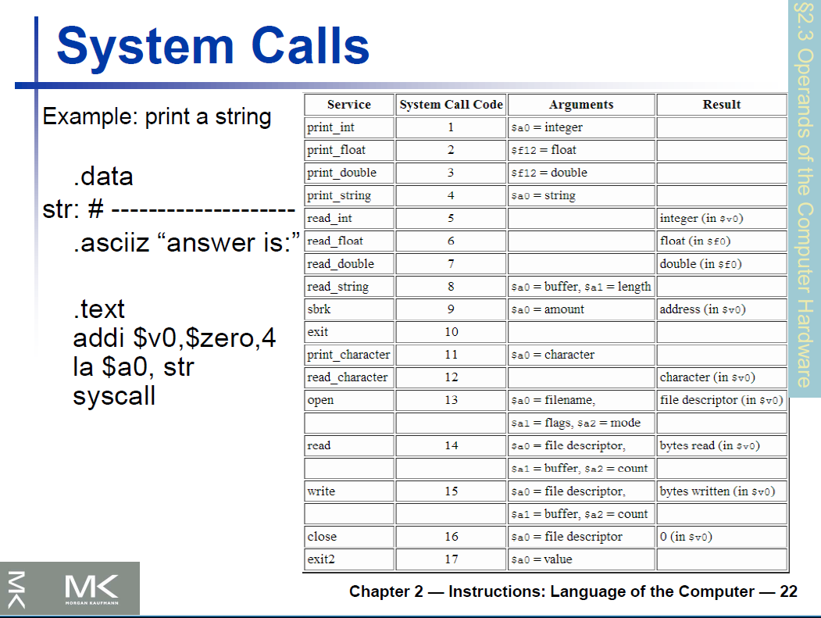
What is a CA/CO

Slide 14
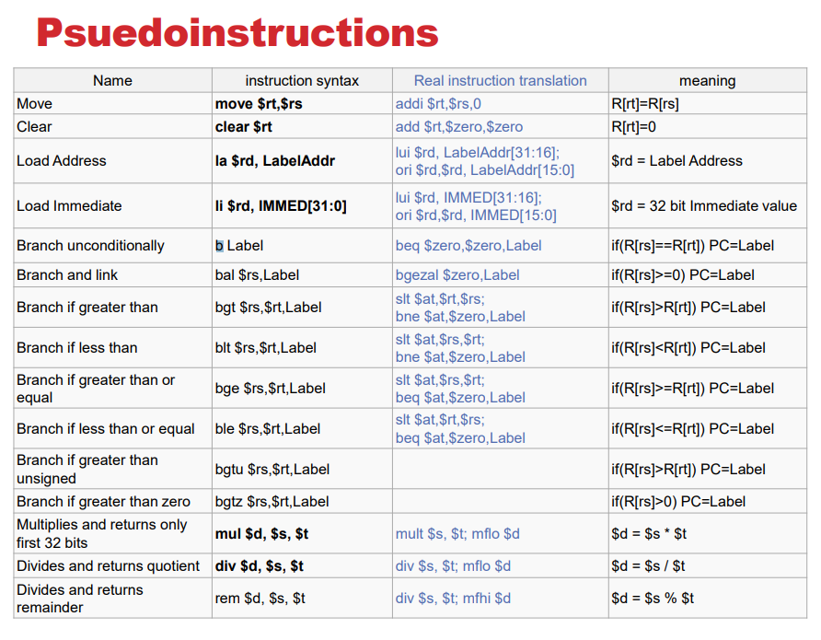
Psuedoinstructios

Slide 15
Structure of MIPS ALP
# Name and general description of program
# Data declarations go in this section.
.data
# program specific data declarations
# Program code goes in this section.
.text
.globl main
main:
# your program code goes here.
# Done, terminate program.
li $v0, 10 # syscall exit
syscall # all done!
.end main

Slide 16
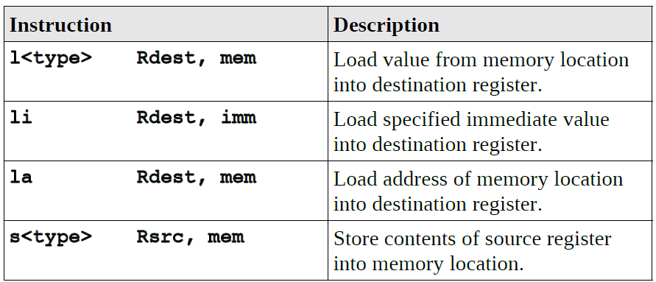
Load/Store instructions
<type> b:byte(8bits), h:half word(16 bits), w:word(32bits)
char c;
c = 'A';
c: .byte 0
li $t0, 'A'
sw $t0, x
int x = 20;
int y;
y = x;
x: .word 20
lw $t0, x
sw $t0, y
int x;
x = 20;
x: .word 0
li $t0, 20
sw $t0, x

Slide 17
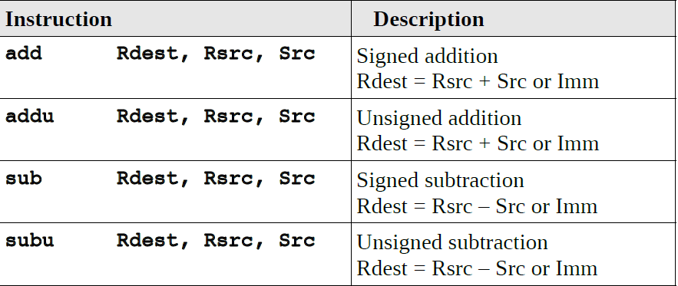
Add/sub instructions
addi Rdest, Rsrc, Imm Rdest = Rsrc + SE(Imm)
addiu Rdest, Rsrc, Imm Rdest = Rsrc + SE(Imm)
subi/subiu -> no such instruction

Slide 18
Add/sub instructions
x = (a – b ) + (c – 5)
Solu 1:
lw $t0, a # $t0 = a
lw $t1, b # $t1 = b
sub $t2, $t0, $t1 # $t2 = a-b
lw $t3, c # $t3 = c
li $t4, 5 # $t4 = 5
sub $t4, $0, $t4 # $t4 = 0 - $t4
add $t5, $t3, $t4 # $t5 = c + (-5)
add $t6, $t2, $t5 # $t6 = (a-b)+(c-5)
sw $t6, x # x = $t6
Solu 2:
lw $t0, a # $t0 = a
lw $t1, b # $t1 = b
sub $t2, $t0, $t1 # $t2 = a-b
lw $t3, c # $t3 = c
addi $t4, $t3, -5 # $t4 = c + (-5)
add $t5, $t2, $t4 # $t5 = (a-b)+(c-5)
sw $t5, x # x = $t6

Slide 19
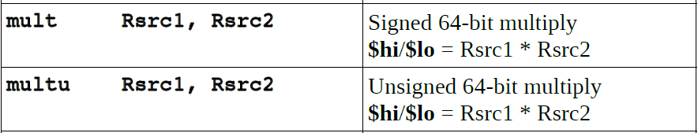
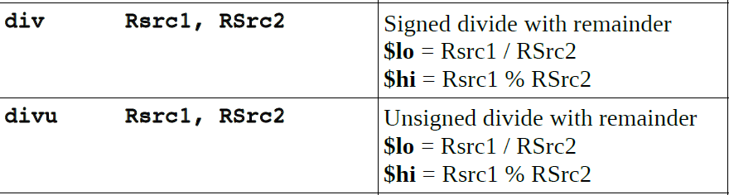
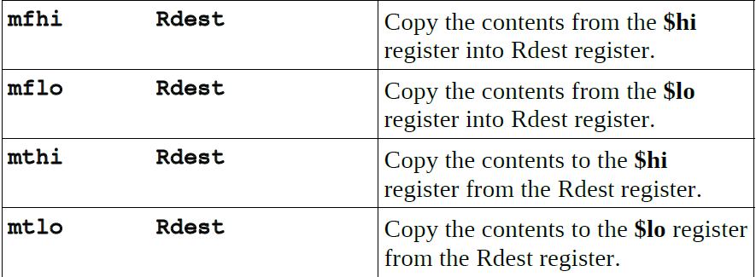
Mul/Div instructions

Slide 20
Mul/Div instructions
int x = 5, y = 10, z;
z = x * y
lw $t0, x
lw $t1, y
multu $t0, $t1 # hi:lo = $t0 * $t1
mflo $t2
sw $t2, z
int x = 5, y = 10, z;
a = x / y;
b = x % y
lw $t0, x
lw $t1, y
divu $t0, $t1 # lo=$t0/$t1; hi=$t0%$t1;
mflo $t2 # $t2 = lo
sw $t2, a # a=Quotient
mfhi $t3 # $t3 = hi
sw $t3, b # b=rem

Slide 21
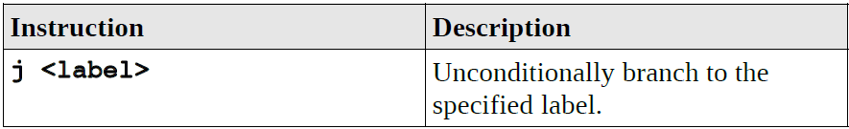
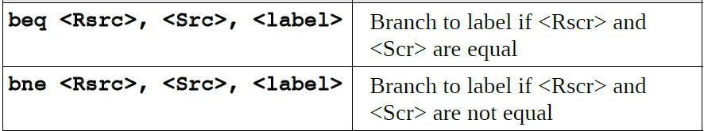
Jump /Cond Branch instructions
If (a == b) {}
if (a != b) {}

Slide 22
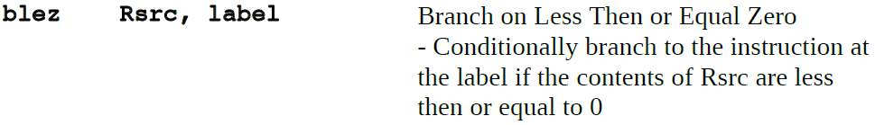
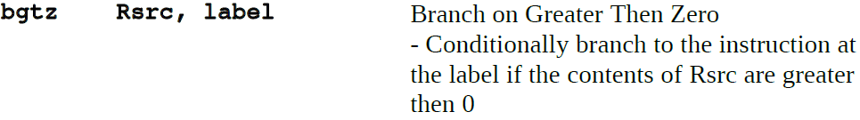
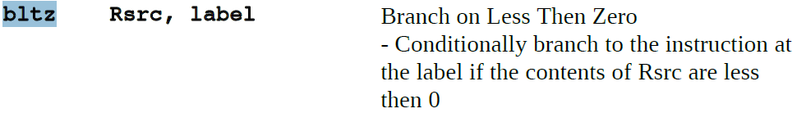
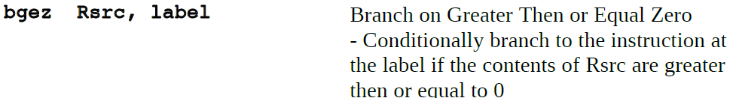
Cond Branch instructions
If ( a <= 0) {}
If ( a > 0 ) {}
If ( a < 0) {}
If ( a >= 0) {}

Slide 23
Compare instructions ?
If (a == b) {} beq $t0, $t1 , L1
if (a != b) {} bne $t0, $t1 , L1
If ( a <= 0) {} blez $t0, L1
If ( a > 0 ) {} bgtz $t0, L1
If ( a < 0) {} bltz $t0, L1
If ( a >= 0) {} bgez $t0, L1
If ( a < b) {} blt
If ( a < 2) {} ??
If ( a > b) {} bgt
If ( a >= b) {} bge
If ( a <= b) {} ble

Slide 24
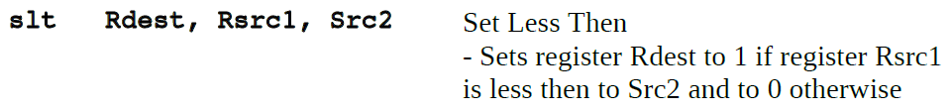
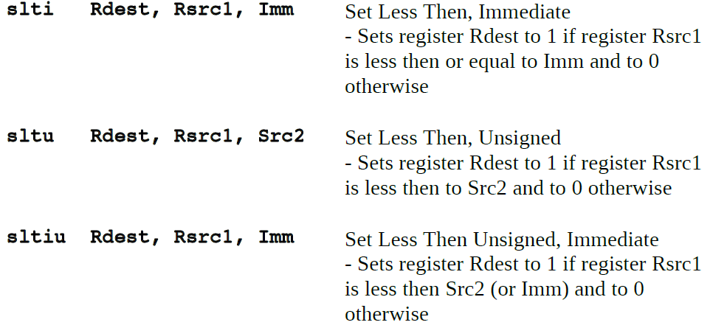
Set … instructions

Slide 25
Jump instructions
If (a == b) {} beq $t0, $t1 , L1
if (a != b) {} bne $t0, $t1 , L1
If ( a <= 0) {} blez $t0, L1
If ( a > 0 ) {} bgtz $t0, L1
If ( a < 0) {} bltz $t0, L1
If ( a >= 0) {} bgez $t0, L1
If ( a < b) {}
lw $t0, a
lw $t1, b
slt $t2, $t0, $t1 # $t2=1 if $t0<$t1 else 0
bgtz L_True # bne $t2, $0, L_True
j L1
L_True:
L1:

Slide 26
Psedo Instru (blt ) instruction
If (a == b) {} beq $t0, $t1 , L1
if (a != b) {} bne $t0, $t1 , L1
If ( a <= 0) {} blez $t0, L1
If ( a > 0 ) {} bgtz $t0, L1
If ( a < 0) {} bltz $t0, L1
If ( a >= 0) {} bgez $t0, L1
If ( a < b) {}
lw $t0, a
lw $t1, b
blt $t0, $t1, L_True #if $t0<$t1 goto L_True
j L1
L_True:
L1:

Slide 27
Psedo Instru (blt ) instruction
# Pseudocode:
# if (a < b + 3)
# a = a + 1
# else
# a = a + 2
# b = b + a
# Register mappings:
# a: $t0, b: $t1
addi $t2, $t1, 3 # tmp = b + 3
blt $t0, $t2, then # if (a < tmp)
addi $t0, $t0, 2 # (else case) a = a + 2
j end
then:
addi $t0, $t0, 1 # (then case) a = a + 1
end: add $t1, $t1, $t0 # b = b + a
9

